Slide 1
WHO recommendations for non-invasive respiratory support for COVID-19
Neill Adhikari, Sunnybrook Health Sciences Centre and University of Toronto
Clinical co-chair, WHO guideline panel
4 August 2022
USAID Global Goods webinar on oxygen updates

Slide 2
Objectives
Review WHO recommendations on non-invasive respiratory support for patients with severe and critical COVID-19
https://www.who.int/publications/i/item/WHO-2019-nCoV-clinical-2022-1

Slide 3
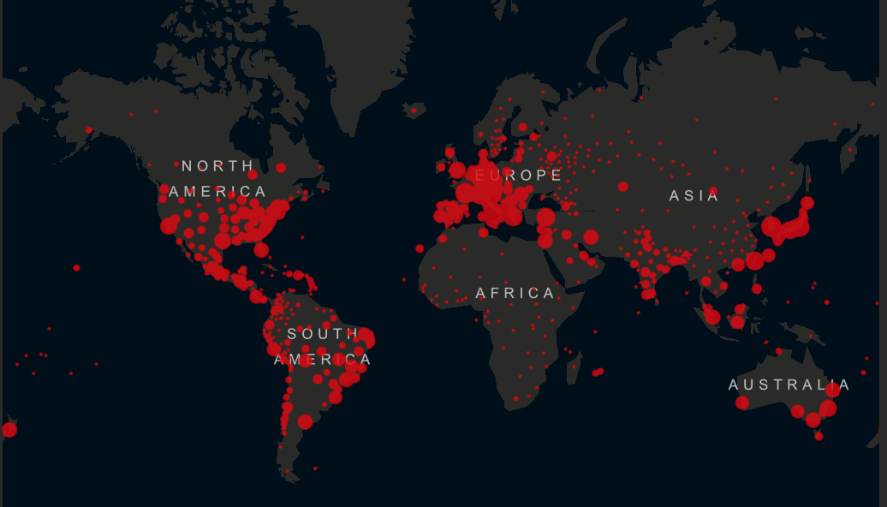
COVID-19 is still an active pandemic
https://coronavirus.jhu.edu/map.html

Slide 4
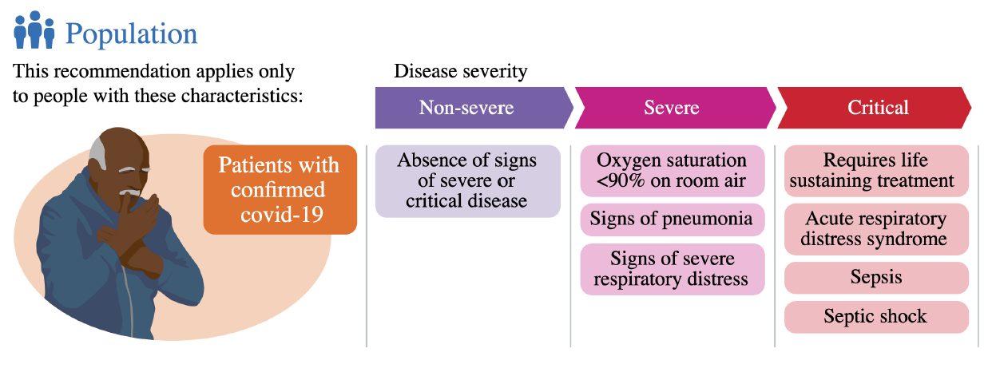
Population
and acute hypoxemic respiratory failure

Slide 5
Methods
Guideline panel had input into initial PICO questions
Systematic review commissioned
Evidence from direct population (COVID-19)
Evidence from indirect population (non-COVID AHRF)
Pairwise meta-analysis
Clinical and methods chairs and WHO met with SR team to clarify results and refine GRADE levels of evidence
Guideline panel considered draft recommendations and provided feedback on additional text

Slide 6
Certainty of evidence (quality of the evidence, confidence in estimates)

Slide 7
Strength of recommendations
What makes a strong recommendation? ‘We recommend…’
Benefits clearly outweigh risks/hassle/cost, OR
Risk/hassle/cost clearly outweighs benefit
What can downgrade strength to a conditional recommendation? ‘We suggest…’
Close balance between up and downsides (benefits/harms)
Values and preferences
Costs, practical limitations
Low certainty evidence

Slide 8
Four options for recommendations
Strong in favour → Almost all informed patients would choose to have the intervention
Conditional in favour → A majority of informed patients would choose to have the intervention, but many would not
Conditional against → A majority of informed patients would choose not to have the intervention, but many would
Strong against → Almost all informed patients would choose not to have the intervention

Slide 9
Sources of evidence
HFNO vs SOT
COVID-19 patients with AHRF: 4 RCTs, n=1053
Non-COVID ARDS: 5 RCTs, n=1425
CPAP vs SOT
COVID-19 patients with AHRF: 1 RCT, n=742
Non-COVID ARDS: 4 RCTs, n=871
Facemask NIV vs SOT
COVID-19 patients with AHRF: none
Non-COVID ARDS: 11 RCTs, n=1254

Slide 10
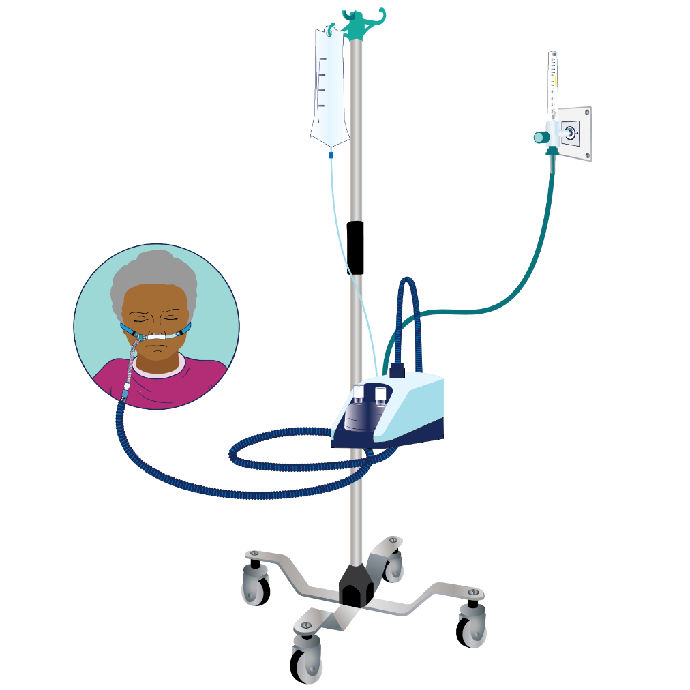
Recommendation 1 - HFNO
In hospitalized patients with severe or critical COVID-19 and acute hypoxemic respiratory failure (AHRF) not needing emergent intubation, we suggest high-flow nasal oxygen (HFNO) rather than standard oxygen therapy (SOT) (conditional recommendation).

Slide 12
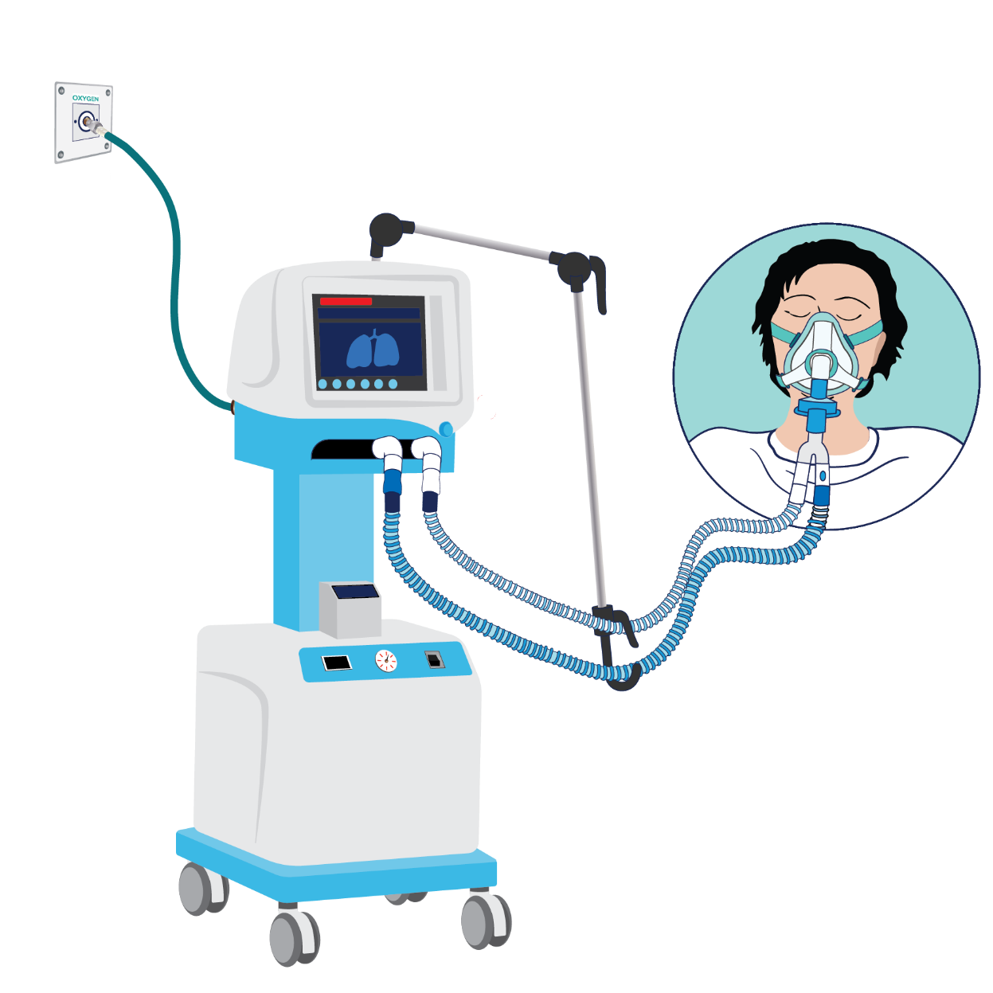
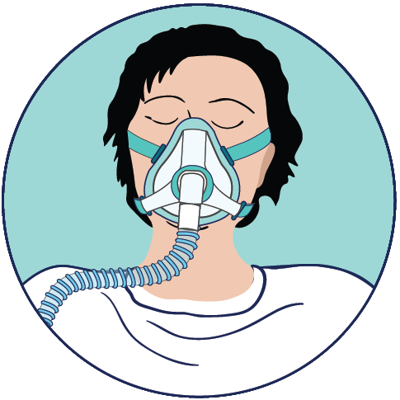
Recommendation 2 - CPAP
In hospitalized patients with severe or critical COVID-19 and AHRF not needing emergent intubation, we suggest CPAP, rather than standard oxygen therapy (conditional recommendation).

Slide 14
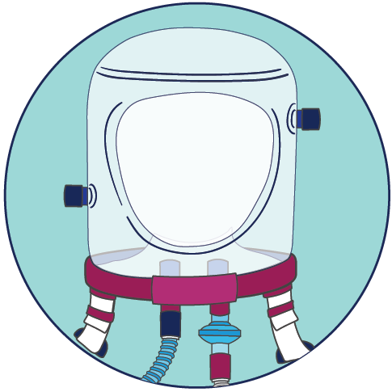
Recommendation 3 - NIV
In hospitalized patients with severe or critical COVID-19 and AHRF not needing emergent intubation, we suggest non-invasive ventilation, rather than standard oxygen therapy (conditional recommendation).

Slide 16
Practical information (based on GDG experience)
HFNO
Initial flow rate 50-60 L/min (2 L/kg/min in children)
CPAP
Initial pressure 5-10 cmH₂O
NIV
Initial EPAP 5-10 cmH₂O, IPAP to achieve Vt 6 ml/kg
All
Titrate to comfort and work of breathing
Initial FiO₂ 100% and titrate FiO₂ to achieve saturation target

Slide 17
All devices – key points
Trials all conducted in high-resource settings
Implementation considerations
oxygen supply
training of healthcare providers
additional equipment for patient monitoring
need for maintenance of equipment
cost
organization of service delivery

Slide 18
No recommendation due to lack of certainty of evidence
HFNO vs CPAP vs NIV
CPAP interfaces
NIV interfaces

Slide 19
Future directions
Additional trials expected of respiratory support devices, including in LMICs
ARISE-AFRICA, NCT04693403
BREATHE trial
Recommendations will be updated as new trial data become available
Network meta-analysis may be informative

Slide 20
Research needs
Between-device comparisons
Interface comparisons
Risks of aerosol generation
Specific populations (e.g., children, pregnant women)

Slide 21
Recommendation implications

