Slide 1
JOINT CLINICAL AND NON-CLINICAL TRAINING
BY: BEATRICE ADU​
TEAM LEAD: NATIONAL MEDICAL GAS MANAGEMENT TRAININGTRAINING

Slide 2
OUTLINE
CYLINDER MANAGEMENT
1. Color code for medical cylinders
2. Ideal color codes for medical oxygen cylinders
3. Cylinders and its accessories
4. Proper handling of cylinders
5. How to tell when the cylinder is empty
BED HEAD UNITS AND ACCESSORIES.

Slide 3
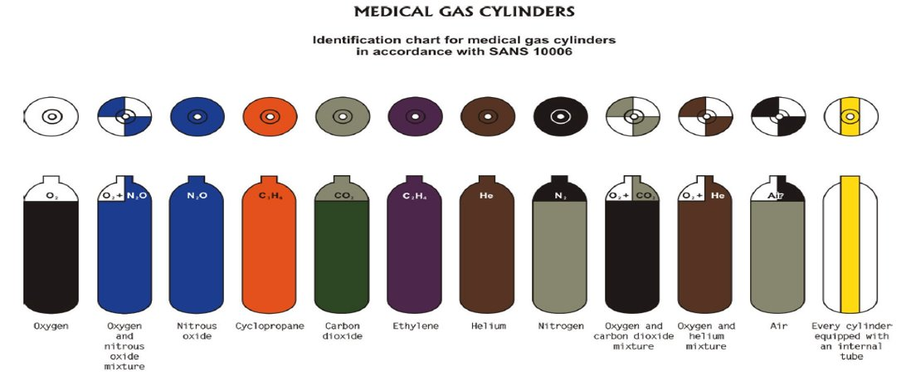
COLOR CODE FOR MEDICAL CYLINDERS​

Slide 4
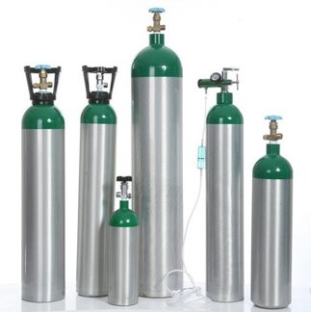
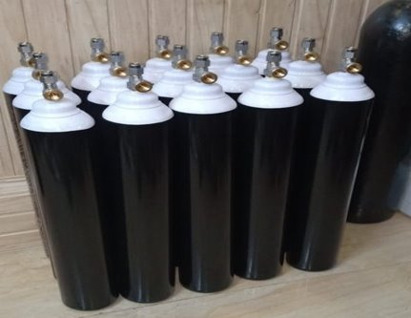
IDEAL COLOR CODE FOR MEDICAL OXYGEN CYLINDERS

Slide 5
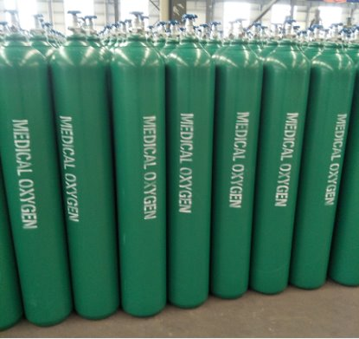
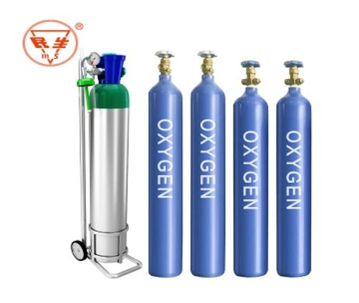
OTHERS

Slide 6
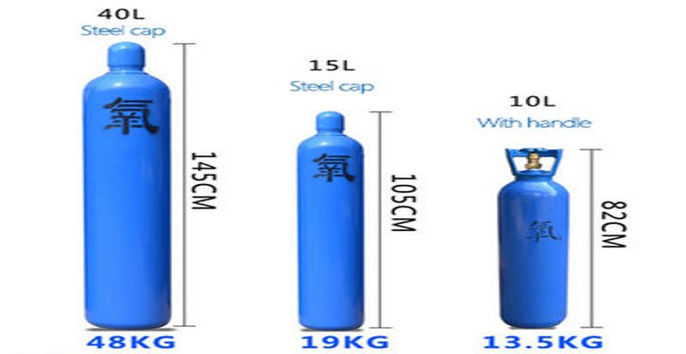

Slide 7
MEDICAL OXYGEN CYLINDER ACCESSORIES

Slide 8
MEDICAL OXYGEN CYLINDER ACCESSORIES

Slide 9
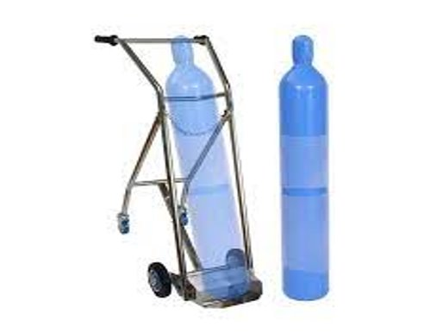
MEDICAL OXYGEN CYLINDER ACCESSORIES​ (CYLINDER TROLLEY)

Slide 10
CYLINDER MANAGEMENT
PROPER HANDLING OF A CYLINDER
1. always use a cylinder trolley when conveying a cylinder
2. Apply breaks of cylinder trolley when trolley is stationary
3. Do not lift a cylinder by their protective cap
4. Always cover the top of cylinder with its protective cap when not in use
5. Gently turn the cylinder valve when ready to open or close
6. Always use the right size of wrench when attaching or detaching a flowmeter to the cylinder.
7. Secure cylinder to a wall when in use on the ward. Eg. Use a wall bracket

Slide 11
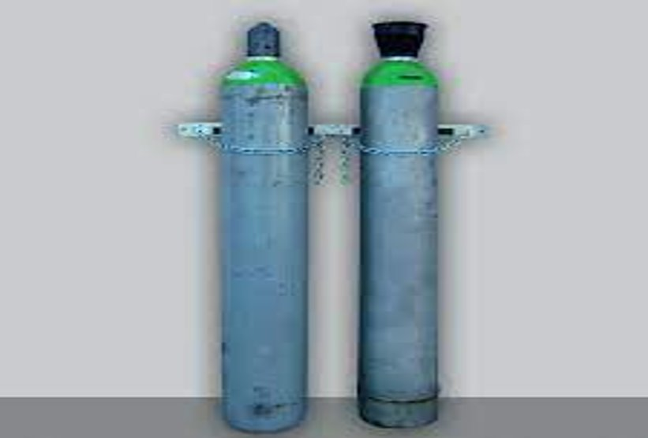

Slide 12
CYLINDER MANAGEMENT
HOW TO TELL WHEN THE CYLINDER IS EMPTY​
With the valve opened, take a look at the manometer​
If the pressure reading on the regulator is close to or on zero, then cylinder is empty

Slide 13
BED HEAD UNITS AND ACCESSORIES
Bed head unit​
Terminal units​
Humidifier bottle and flowmeter​
Best practice for use of Bed head units​
Best practice for handling flowmeters and humidifier bottles

Slide 14
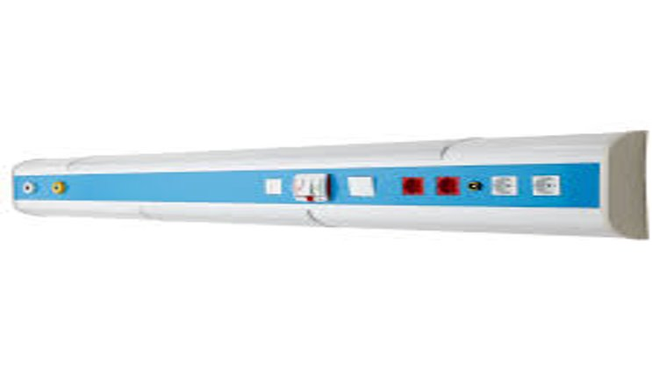
BED HEAD UNIT

Slide 15
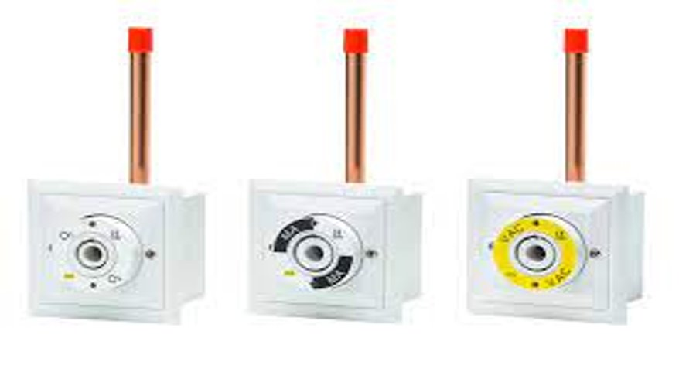
TERMINAL UNITS

Slide 16
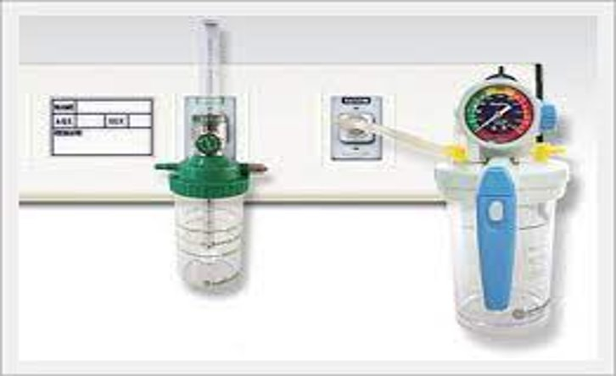
HUMIDIFIER BOTTLE AND FLOWMETER

Slide 17
BEST PRACTICE FOR USE OF BED HEAD UNIT
Do not spill fluids on it or clean immediately when that happens​
​
At the sound of a leakage, quickly alert engineers and do not use

Slide 18
BEST PRACTICE FOR HANDLING FLOWMETERS AND HUMIDIFIER BOTTLES
Always use distilled water in humidifier bottles​
Do not exceed the maximum limit for water filling​
Do not throw away the seal on the cover of the humidifier​
Do not leave water in bottle when not in use​
Disinfect the humidifier bottle after discharging each patient (or dust where necessary)

Slide 19
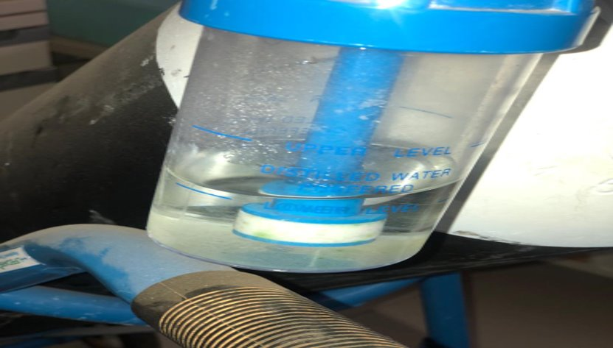
STAGNANT WATER LEFT IN A HUMIDIFIER FOR WEEKS

Slide 20
HOW TO CLEAN A HUMIDIFIER
Empty the humidifier bottle​
Wash inside and out with mild soap and water​
Rinse with a disinfectant ​
Follow with a hot (not boiling) water rinse​
Then refill the humidifier bottle with distilled water​
If not in use immediately, air dry on a paper towel​

Slide 21
RINSE WITH A DISINFECTANT
Note that some manufacturer’s instructions for use require the humidifier bottle to be rinsed daily with a solution of 10 parts water and one part vinegar as a disinfectant. ​
Avoid touching the inside of the bottle or lid after it has been cleaned and disinfected to prevent contamination.

Slide 22
THE END
THANK YOU.
BY:BEATRICE ADU​
TEAM LEAD: NATIONAL MEDICAL GAS MANAGEMENT TRAINING

