Slide 1
Airway, Breathing and Oxygen Therapy
Dr. Davidson Iroko
18/03/2022

Slide 2
Outline ​
Airway assessment and management​
Breathing assessment and management​
Oxygen therapy​

Slide 3
Introduction
ABCDE approach provides a framework for the systematic and organized evaluation of acutely ill patients in order to rapidly identify and intervene for life-threatening conditions.​
The following slides will focus on the Airway and Breathing component of the ABCDE.​

Slide 4
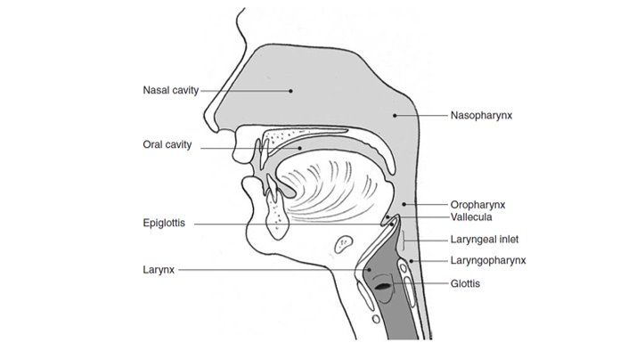
Recap – Airway Anatomy

Slide 5
Airway Assessment​
MAIN CONCERN: IS THE AIRWAY PATENT?​
Can the patient talk normally? If YES, the airway is open.​
If the patient cannot talk normally:​
look to see if the chest wall is moving and listen to see if there is air movement from the mouth or nose.​
listen for abnormal sounds (such as stridor, grunting, or snoring) or a hoarse or raspy voice that indicates a partially obstructed airway.​
Stridor plus swelling and/or hives suggest a severe allergic reaction (anaphylaxis).​
Look and listen for fluid (such as blood, vomit) in the airway.​
Look for foreign body or​
abnormal swelling around the airway, and altered mental status.​
Check if the patient is able to swallow saliva or is drooling.​

Slide 6
Airway management 1​
AIM OF MANAGEMENT IS TO OPEN/KEEP AIRWAY OPENED.​
If the patient is unconscious and not breathing normally and:​
NO TRAUMA: open the airway using the head-tilt and chin-lift manoeuvre. ​
CONCERN FOR TRAUMA: maintain cervical spine immobilization and open the airway using the jaw thrust manoeuvre. ​

Slide 7
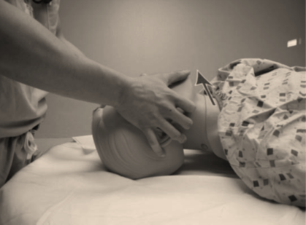
Jaw Thrust
Position yourself at the head of the patient​
place the hands at the sides of the patient’s face​
Grasp the mandible at its angle, and lifts the mandible forward ​
This lifts the jaw and opens the airway with minimal head movement​
Safest method for opening the airway if there is the possibility of cervical spine injury​

Slide 8
Airway management 2​
If secretions or vomit are present, suction when available, or wipe clean. ​
Place an oropharyngeal or nasopharyngeal airway to maintain the airway.​
If a foreign body is suspected:​
If the object is visible, remove it – be careful not to push the object any deeper.​
If the patient is able to cough or make noises, keep the patient calm and encourage coughing.​

Slide 9
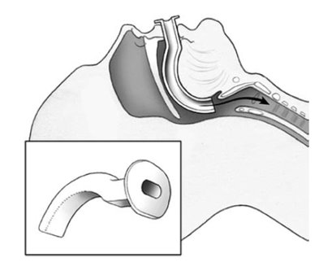
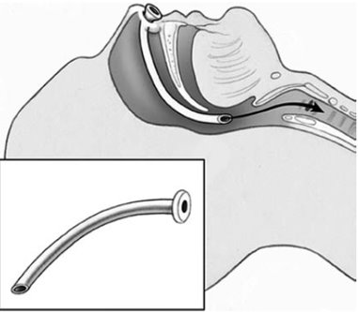
Airway Adjuncts​
Oropharyngeal airway​
Nasopharyngeal airway​

Slide 10
Airway Management 3​
If the patient is choking and is unable to cough, not making sounds use age-appropriate chest thrusts/ abdominal thrusts/back blows.​
If the patient becomes unconscious while choking, follow relevant CPR protocols.​
Consider placing the patient in the recovery position if the rest of the ABCDE is normal and no trauma is suspected.​
If the patient has swelling, hives or stridor, consider severe allergic reaction (anaphylaxis), and give intramuscular adrenaline.​

Slide 11
Breathing Assessment​
Look, listen, and feel to see if the patient is breathing.​
Assess if breathing is very fast, very slow, or very shallow.​
Look for signs of increased work of breathing (such as accessory muscle use, chest indrawing/retractions, nasal flaring) or abnormal chest wall movement.​
Listen for abnormal breath sounds such as wheezing or crackles.​
With severe wheezing, there may be limited/no breath sounds on examination because narrowing of the airways may be so severe that breathing cannot be heard.​
Listen to see if breath sounds are equal on both sides.​
Check for the absence of breath sounds and dull sounds with percussion on one side (large pleural effusion or haemothorax).​
If there are no breath sounds on one side, and hypotension, check for distended neck veins or a shifted trachea (tension pneumothorax).​
Check oxygen saturation with a pulse oximeter when available​

Slide 12
Breathing management 1​
If unconscious with abnormal breathing, start bag-valve-mask ventilation and follow relevant CPR protocols.​
If not breathing adequately (too slow for age or too shallow), begin bag-valve-mask ventilation with oxygen. ​
If oxygen not immediately available, DO NOT DELAY ventilation. Start ventilation while oxygen is being prepared.​
If breathing fast or hypoxic, give oxygen.​
If wheezing, consider giving nebulised salbutamol. Repeat salbutamol as needed.​
If concern for severe allergic reaction (anaphylaxis), give intramuscular adrenaline.​

Slide 13
Breathing management 2​
If breathing fast or hypoxic, give oxygen.​
If wheezing, consider giving nebulised salbutamol. Repeat salbutamol as needed and treat underlying cause.​
If concern for severe allergic reaction (anaphylaxis), give intramuscular adrenaline.​
If concern for heart failure, provide oxygen as required and get help/treat as appropriate.​

Slide 14
Breathing management 3​
If concern for tension pneumothorax, perform needle decompression immediately and give IV fluids and oxygen. Chest tube should be inserted. Plan for rapid handover/transfer especially if cannot insert chest tube.​
If concern for large pleural effusion or haemothorax, give oxygen and plan for rapid handover/transfer.​
If sucking chest wound (open pneumothorax), apply 3-sided occlusive dressing while arranging for chest tube​
Many of the life-threatening breathing conditions require chest tube insertion. If unable to perform this, refer after initial resuscitation.​

Slide 15
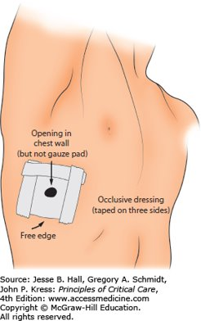
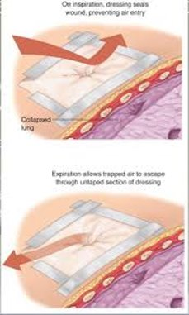
3-sided occlusive dressing for open pneumothorax​

Slide 16
Oxygen therapy​
This will be addressed in another presentation

Slide 17
Conclusion ​
The ABCDE approach provides a framework for the systematic and organized evaluation of acutely ill patients in order to rapidly identify and intervene for life-threatening conditions. ​
This presentation focused on the Airway and Breathing.​
The other aspects of the ABCDE approach are assessment & management of circulation, disability (neurology) and exposure and environmental control.​
In trauma, the life-threatening conditions one should identify include airway obstruction, tension pneumothorax, open pneumothorax, massive haemothorax, flail chest with underlying lung contusion, cardiac tamponade, and circulatory shock.​
After resuscitating with ABCDE approach and patient is stable, take SAMPLE history and perform secondary survey.​

