Slide 1

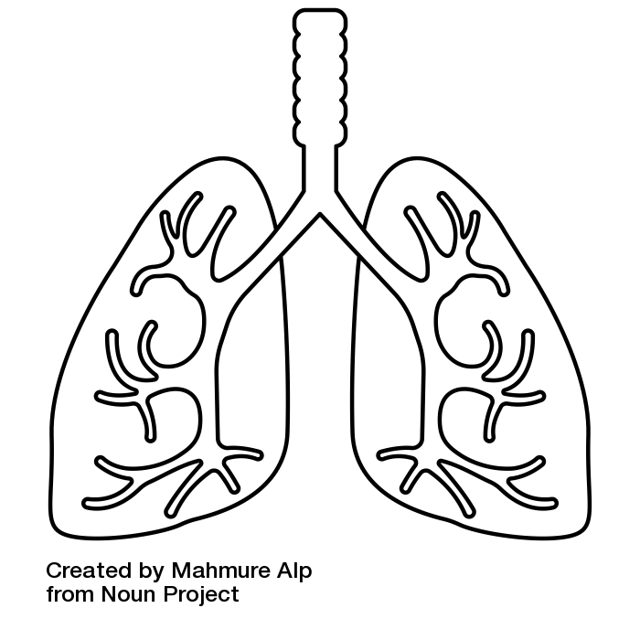
massive hemoptysis
onepagericu.com
@nickmmark
@mramzyDO
Link to the most current version →
by Nick Mark MD & Mark Ramzy DO
ONE
DEFINITIONS:
“Enough bleeding to make you nervous is probably massive”
Hemoptysis = bleeding from below vocal cords
Pseudo-hemoptysis = upper respiratory tract (e.g. epistaxis) or GI bleeding (mimics hemoptysis)
Massive hemoptysis = life threatening bleeding, not necessarily defined by the amount (100-1000ml) or rate of bleeding (>100 ml/hr) but has potential to cause death by asphyxia or blood loss.
BLEEDING LOCALIZATION & INTERVENTIONS
Bronchoscopy
· Diagnostic & therapeutic; best in life-threatening bleeding
· Rigid preferred but requires expertise & not always readily available
APPROACH:
· Management is patient and disease specific
· TB is the most common cause worldwide. Bronchiectasis, necrotizing pneumonia & lung cancer are most common in the US.
AIRWAY MANAGEMENT & POSITIONING
rotate bleeding side down
Rotation partially isolates blood to the dependent side; however it may be difficult to identify the side with bleeding using clinical exam or even imaging.
GENERAL MANAGMENT
BRONCHOSCOPIC INTERVENTIONS
WORKUP
cold saline (50 cc ns boluses)
Temporarily effective until further medical or surgical stabilization
epinephrine (1:100,000 5ml)
Risk of Ventricular Arrhythmias
Effectiveness limited by dilution
topical TXA (500 – 1000 mg)
Minimal to no short-term recurrence
Studies show ↓ bleeding by 2nd day
bronchial blockers
Fogarty balloon catheter effective temporizing measure in first 48-72 hrs
Inflate to 30-50 mmHg
ablation, Cautery, Cryo
Limited anecdotal evidence for cautery
No role for cryotherapy in massive hemoptysis due to delayed effect
argon plasma
Effective electrocautery if the bleeding site can be adequately visualized
correct coagulopathy
· Reverse anticoagulants (FFP, Cryo, Vit K)
· Treat platelet dysfunction (ddAVP)
transfuse if necessary
· No exact cutoff defined in literature
· Highly Recommended if Hgb < 10 mg/dL and actively bleeding
· Increased mortality if transfusion needed
nebulized txa (500 mg/5ml TID)
· Reduces need for invasive procedures
labs
· CBC, BMP, LFT, PT/PTT/INR, Type & screen
· Consider Thromboelastography (TEG)
(faster, identifies multiple abnormalities)
· Also consider infectious workup & autoimmune labs (ANA, anti-GBM, etc)
cxr
· Poor sensitivity to detect bleeding site but a useful first step
chest ct
· Best if PE suspected. Complementary to bronchoscopy. Helps identify bronchial artery anatomy. Limited utility in unstable patient (consider airway prior to scanning)
protect airway
An effective cough and preserved airway reflexes may be the best way to protect the airway. If the patient is unable to clear hemoptysis, or if hypoxemia or altered mental status are present intubation may be necessary. When intubating consider:
· Call for help (high risk for difficult airway) & verbalize airway plan
· Entire team should wear full PPE
· Try to minimize risk of losing visibility: head-up positioning; use of DL instead of VL; have two large suctions ± meconium aspirator
· Consider the choice of ETT; weight the pros/cons of each:
standard ETT
mainstem ETT
bronchial blocker
rigid bronchoscopy
· Readily available
· Does not isolate bleeding
· Does ventilate both lungs
· If possible, use larger size ETT (8.0) to facilitate suctioning & bronchoscopy
· May isolate bleeding to one lung
· Only ventilates one lung; must decrease TV if using VC ventilation.
· Bronchoscopically deployed balloon isolates bleeding to a a single lobe or segment
· Can be placed through an ETT ≥ 7.5 (not a dual lumen)
· If bleeding from central airway lesion, rigid bronchoscopy may be beneficial if available
· Avoid Dual Lumen ETT
(difficult to place and lumen size may limit use of bronchoscopy)
D/Dx: BATTLECAMP
B – Bronchitis / Bronchiectasis
A – Aspergilloma / AV Malformation
T – Tuberculosis
T – Tracheal-innominate Fistula
L – Lung Cancer/metastasis or Abscess
E – Pulmonary Embolism
C – Cocaine / Coagulopathy / Catemenial / Cystic Fibrosis
A – Autoimmune (SLE, vasculitis)
A – Alveolar Hemorrhage (DAH)
M – Mitral Stenosis
P – Pneumonia / Paragonimiasis
+ Iatrogenic (PAC, TBBx, TI fistula, etc)
+ Cryptogenic (up to 18% of cases)
Bronchoscope should be used to guide ETT into unaffected lung (avoid accidental misplacement)
Flexible bronchoscopy w/ large working channel
INTERVENTIONAL RADIOLOGY
bronchial artery embolization
High success rates (60-90%) with BAE
Risk of off target embolization (spinal artery, esophagus)
Very effective for Pulmonary AVMs
Recurrent bleeding likely for TB, aspergilloma, bronchiectasis and bronchogenic carcinoma
Complications such as chest pain and dysphagia are usually self-limiting
Rigid bronchoscopy enables interventions in proximal airway
Airway protected but blood can spread from the site of bleeding & impair gas exchange bilaterally
Ventilator connection
Balloon deployed to bleeding segment
CC BY-SA 3.0 v1.1 (2020-12-27)
SURGICAL MANAGEMENT
May be particularly useful for PA ruptures, leaking aortic aneurysm, AV malformations, traumatic injuries & trachea-innominate bleeds, etc
90% of bleeds arise from the high-pressure Bronchial Artery circulation (not the pulmonary arteries)

