Slide 1
Mechanical Ventilation

Slide 2
What would you do?
You are called to the ED to see a 64 yo woman with COPD who appears to be here with a COPD exacerbation.
PE: T 38 C, HR 110, RR 28, BP 110/70 moderate respiratory distress, accessory muscle use, decreased bilaterally with prolonged expiration
CXR: hyperinflation, no consolidations
ABG: 7.3/60/58, 88% on 2L NC

Slide 3
You choose to closely monitor her, start systemic corticosteroids, doxycycline, and nebs. Which of the following is MOST appropriate?
Increase O2 & give continuous albuterol
Continuous albuterol only
Intubation & Mechanical Ventilation
Noninvasive PPV (BiPAP)
Notes:
Answer is D.

Slide 4
Mechanical Ventilation Goals
Relieve Respiratory Distress
Decrease Work of Breathing
Improve Gas Exchange
Support respiration while other organs recover
Do so while avoiding complications of PPV

Slide 5
Mechanical Ventilation Indications
Hypoxemia
Hypercarbia
Coma or inability to protect airway
Procedures
Hemodynamic Instability (relative)

Slide 6
Case continued
Eventually NIV was deemed ineffective and she is intubated. The tube passes easily and placement is confirmed with end-tidal CO2. She is initially bagged at a rate of 25 bpm. Immediately after intubation her BP drops (70/40).

Slide 7
Take a deep breath
What is happening here?
Sepsis
Pneumothorax
Increased intrathoracic pressure (“auto-PEEP”)
Myocardial Infarction
Notes:
Answer is C.

Slide 9
After you stop freaking out…
What should you do next?
Give more IV fluid
Put a needle in the chest – left anterior intercostal
Stop bagging the patient and allow for exhalation
Start norepinephrine
Notes:
Answer is C.

Slide 10
Complications of Intubation
Inability to ventilate
Inability in intubate
Hypotension
Aspiration
Hypoxemia
Arrhythmia
Dislodge loose teeth
Beware co-morbidities (PH, AS, obesity)

Slide 11
Complications of MV/PPV
Barotrauma (aka Ventilator induced lung injury)
Ventilator Associated Pneumonia
Weakness with prolonged MV
Tracheal Stenosis
Trauma to airway
Skin breakdown associated with tube and fasteners
Need for Pain & Sedation Meds

Slide 12
Settings
Positive pressure ventilation (PPV) is very simple
Air is delivered to the patient under pressure
You determine the amount (volume) or force (pressure)
You determine the rate, you let the patient breath spontaneously, or you allow a combination.
Finally, you determine the FiO₂ and PEEP

Slide 13
The BP improved…
What ventilator settings would be most appropriate for this 60 kg patient?
VC, RR 22, TV 400mL, PEEP 5cm H₂O, FiO₂ 1
VC, RR 12, TV 500mL, PEEP 5cm H₂O, FiO₂ 0.6
VC, RR 20, TV 700mL, PEEP 5cm H₂O, FiO₂ 0.6
PC, RR 15, PIP 25cm H₂O, PEEP 5cm H₂O, FiO₂ 1
Notes:
Answer is B.

Slide 15
Typical Ventilator Order Includes
Mode
Respiratory Rate
Volume or Inspiratory Pressure
FiO₂ or directions for titrating
Positive end-expiratory pressure (PEEP)
That’s it. The RT programs the rest - I:E, flow rate (in VC), alarms, etc.

Slide 16
Variables
Oxygenation
Ventilation (CO₂)
FiO₂
PEEP
Mean Airway Pressure (P_{aw})
RR
Tidal Volume
Peak inspiratory pressures (PIP) – Pressure required to overcome resistance
Plateau Pressures (PP) – surrogate for Transpulmonary Pressures, measured at end-inspiration
Compliance – how stiff is the lung?
Auto-PEEP (aka intrinsic PEEP) – measured with end-expiratory hold maneuver

Slide 17
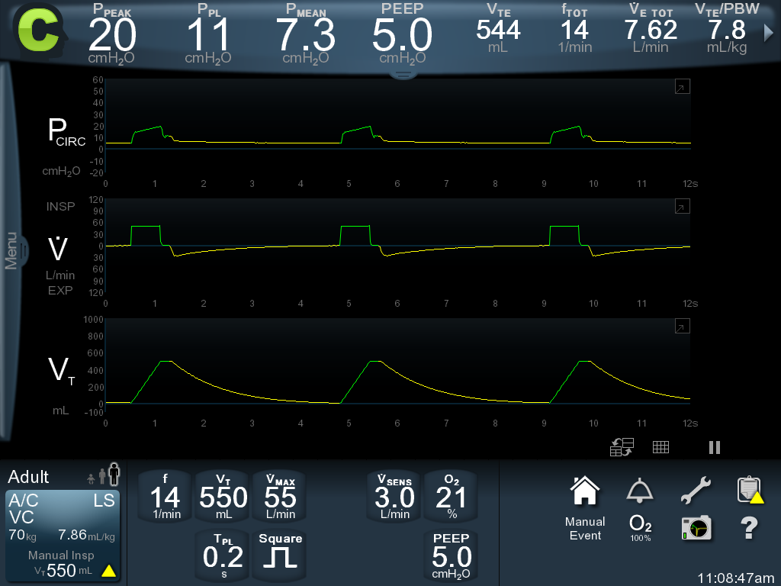
Wave Forms
Insert typical wave for with labels to define each variable from the prior slide.

Slide 18
Back to you COPD patient
You put the patient on volume control at a rate of 16 and a tidal volume of 600 mL. Which one statement is true of the tidal volume delivered if the measured rate is 22.
600 mL every breath
600 mL during the 16 set breaths, & pt triggered breaths determined by effort
Tidal volume determined by pt efforts each breath
Tidal volume depends on lung compliance
Notes:
Answer is A.

Slide 19
Modes
Variable | Volume Control | Pressure Control | Pressure Support
Volume | Same every breath | Depends on pt effort and lung compliance | Depends on pt effort and lung compliance
Pressure | Depends on lung compliance | Same every breath | Same every breath
Rate | Minimum set, but pt can trigger spontaneously | Minimum set, but pt can trigger spontaneously | Completely Spontaneous
Flow rate | Same every breath | Depends on pt effort and lung compliance | Depends on pt effort and lung compliance
Waveforms | Pressure-time Pressure-volume loop | Volume-time Flow-time | Volume-time
Notes:
For the waveforms, the important point is that you want to look at the waveforms that can change breath to breath depending on the mode and compliance.

Slide 20
Wave Forms
Video/graph of each wave form specific to each mode with anotations.
Notes:
VC normal

Slide 21
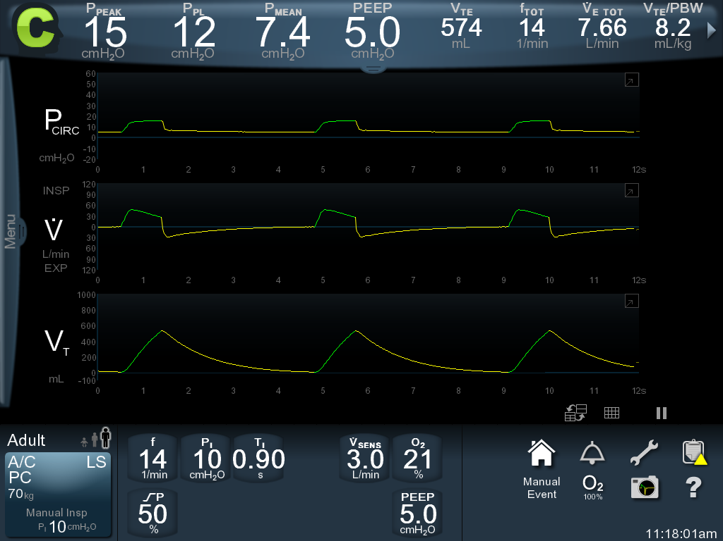
Notes:
PC normal

Slide 22
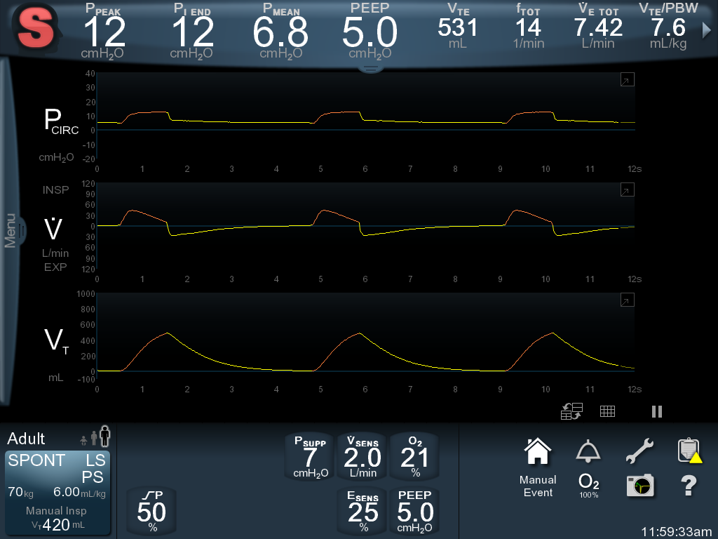
Notes:
SBT

